Slide 1




Background Subtraction Using Local SVD Binary Pattern
B.S.C.S. Franci Suni Lopez
B.S.C.S. Joel Gallegos Guillen

Slide 2
Approach
Strong method for changes of ilumination.

Slide 3
Code
Source code on Python
python localsvd2016 -g highway/groundtruth -f highway/input -k 1700

Slide 4
Core
For each pixel of the N frames Extract the LSBP (Local SVD Binary Pattern ) descriptor
Local Binary Pattern (LBP)
Singular Value Decomposition (SVD)

Slide 5
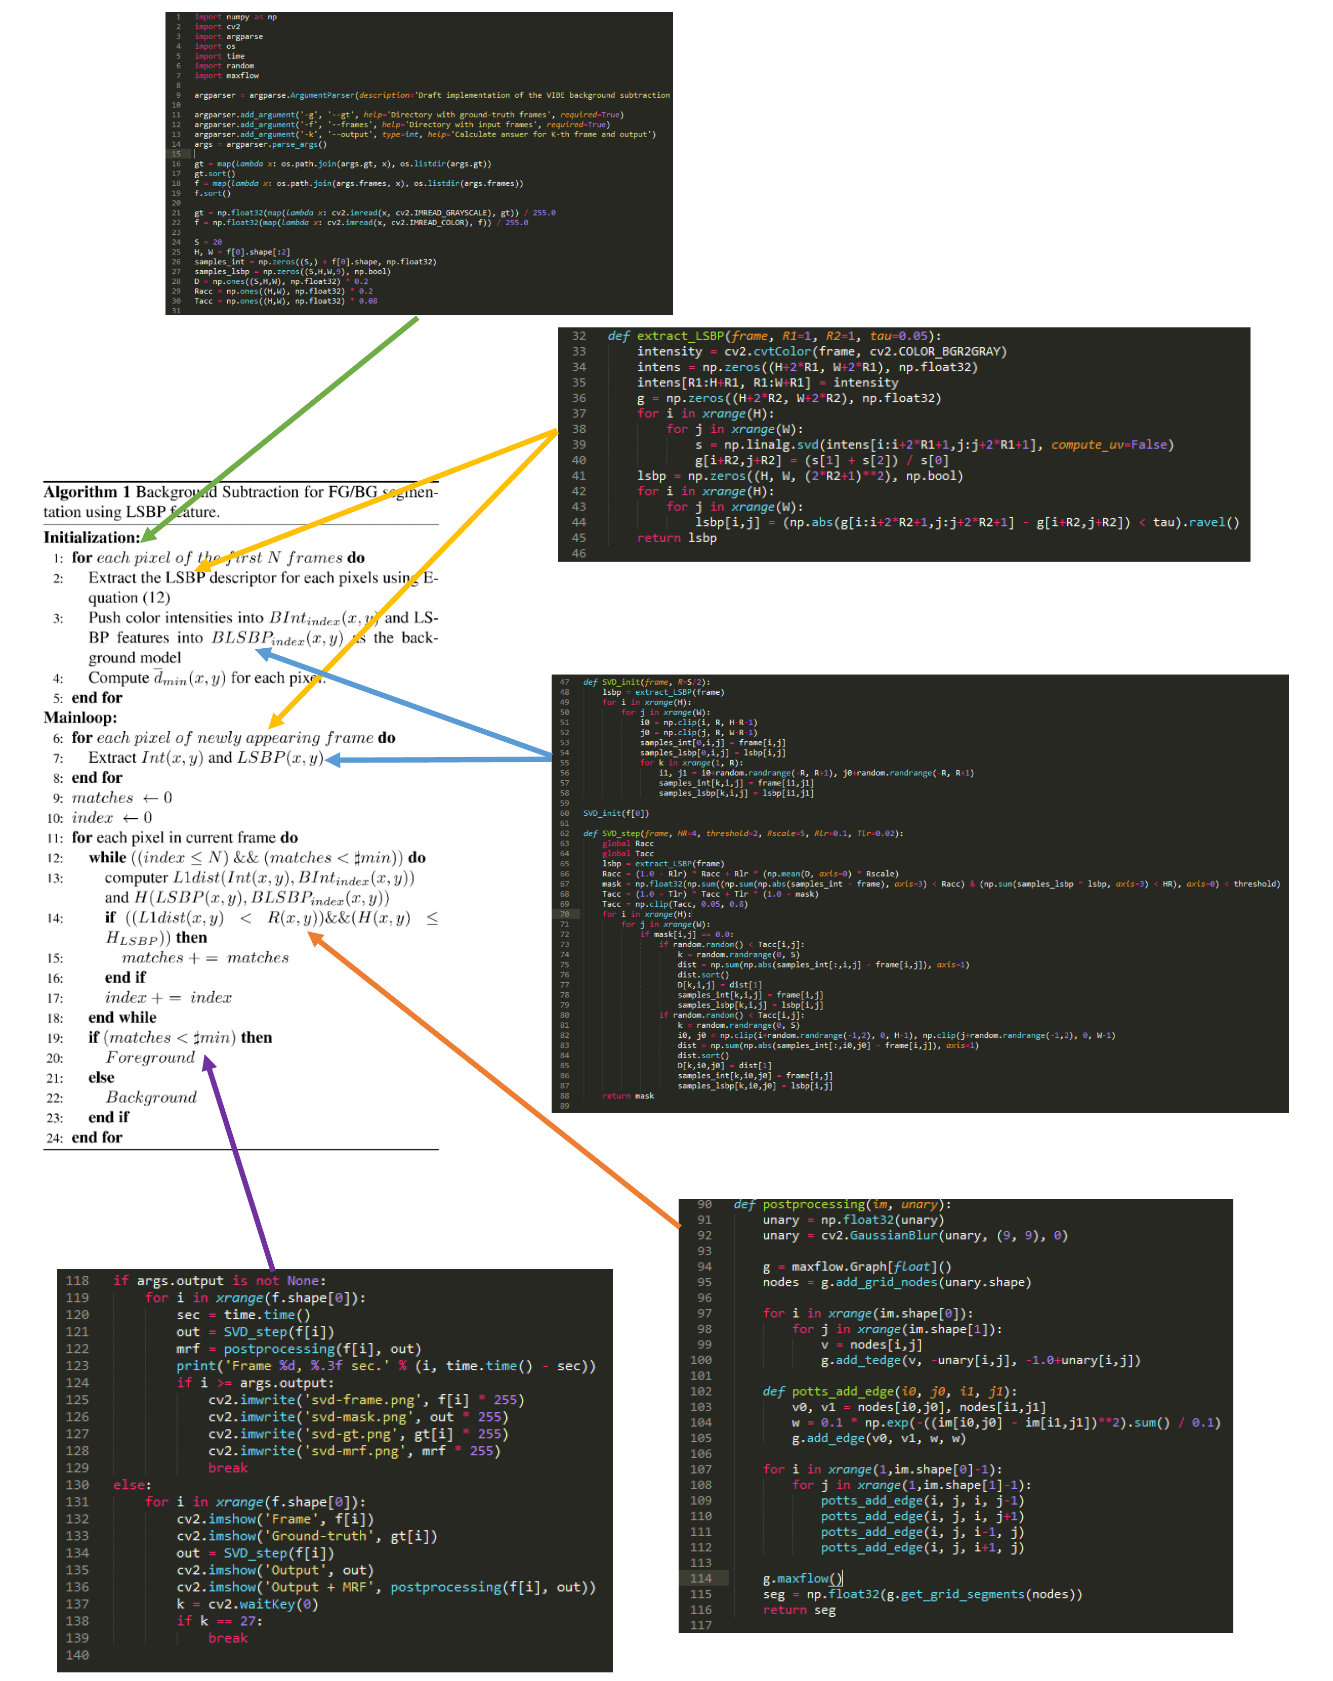

Slide 6
Results

Slide 7
Thanks!
Questions?

